Slide 1
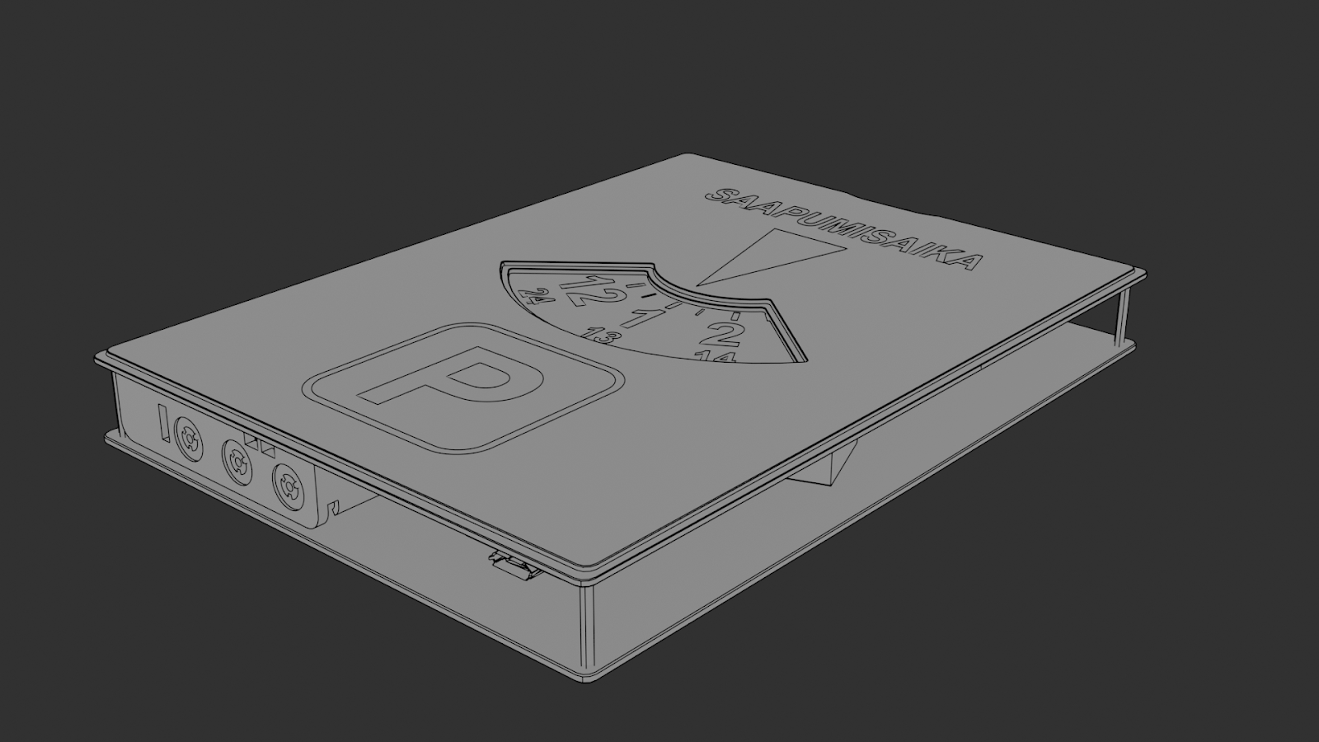
Self-moving parking disc
Group 19

Slide 2
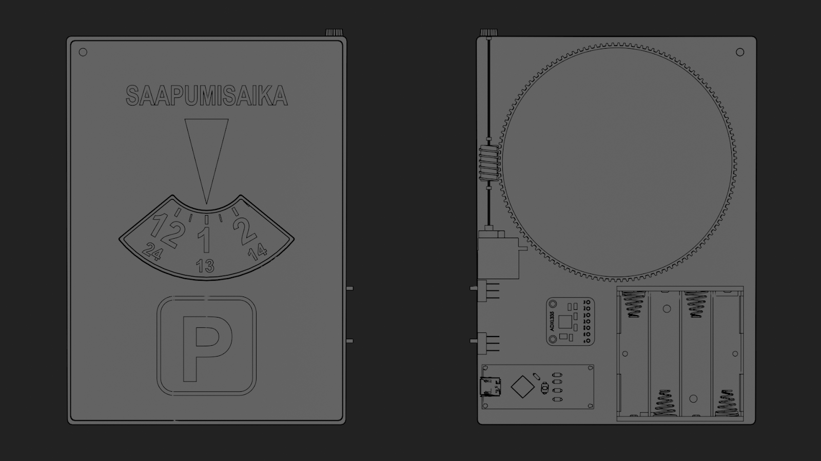
Introduction report 1/2
- What is your concept? Describe the concept in detail.
Our concept is an automatic parking disc. A parking disc is needed to prevent parking tickets. A lot of parking lots have limited time that a certain car can park there. It shows the time of arrival for a traffic warden. We came up with a solution for not having to change the time of arrival manually. Our parking disc will do it automatically.
The disc will recognize when a car stops moving by using an accelerometer. When the Arduino recognizes that a car is parked (no accelerometer signal) it will stop rotating the parking disc and starts counting time. Every 12-hour count starts again until the Arduino recognizes that a car is on move. When the Arduino receives a strong enough signal from the accelerometer it will spin a motor that spins the disc equal to the time the car is parked. The disc is spinned every 60 seconds until the Arduino recognizes that the car is parked.
- How did you arrive at this concept? Describe your process.
Our process started with thinking about what would be useful and beneficial in everyday life and what would be possible to implement with the available resources. Our version of a parking disc would be handy, save us time, and everyone needs a parking disc, so we chose to go through with this idea.
- What were your design sketches? Describe functionality, other options you considered while deciding on your design.
We considered whether we wanted to make a digital or a traditional-looking parking disc, and in the end we decided to go with the latter. However, instead of making our disc out of plastic as it usually is, we want to use plywood.

Slide 3
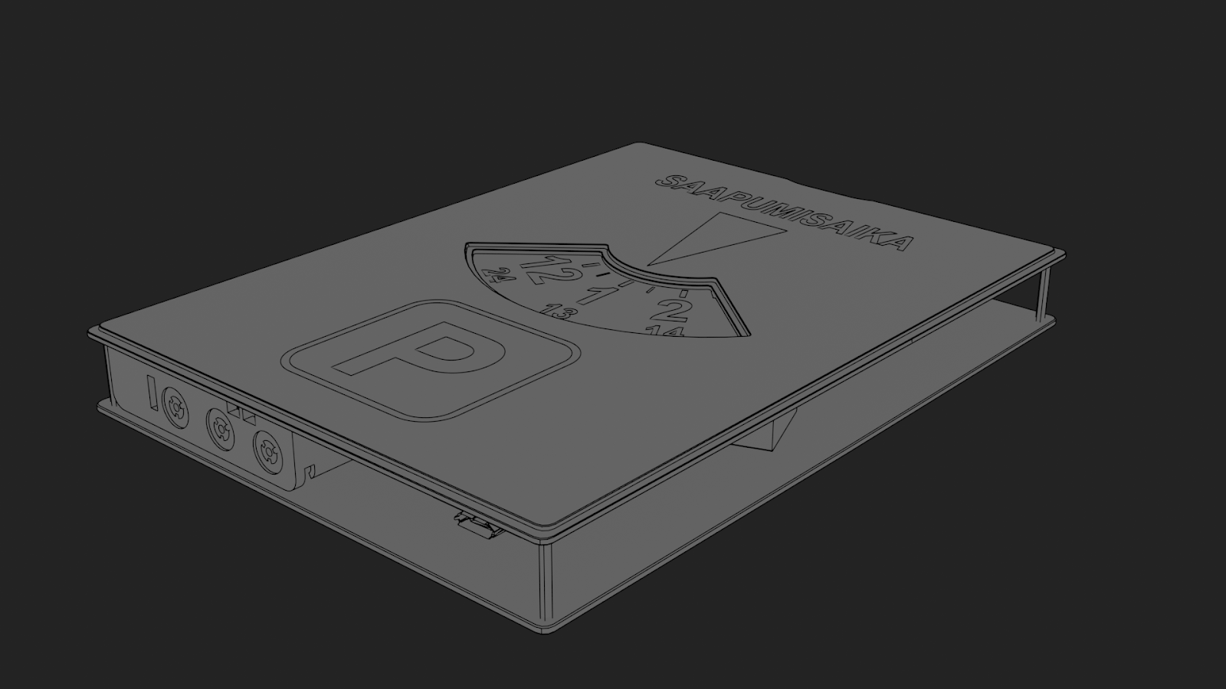
Introduction report 2/2
- How this can be realized? Describe processes, materials, initial bill of materials.
Ordering electronic parts & rod
Laser cutting top/bottom covers
3D-printing cutting disc
3D-printing screw like gear train
Designing code
Putting parts together
Materials: Plywood, PLA printing filament and screws
- What is your reflection on your process?
We think we are well on track with the project and that it has progressed well so far. We found a topic for the project that interests all members of the team and suitable role and tasks for each of us. We believe that the project has a good level of challenge but is also feasible within the given time frame and our skill set.

Slide 4
Part list
The parking disc includes these parts:
Top cover (have text “saapumisaika” on it).
Bottom cover
Disc (where the numbers are and gear train)
Arduino Nano
4xAAA battery holder/base
Accelerometer
Rod with screw like gear train
Manual time adjustment head for rod
Micro servo motor
Spacers between covers

